Slide 1
Woodlands CS Club
Recursion part 2
Group A
11/30/2020

Slide 2
Table of Contents
Review of last week
https://dmoj.ca/problem/ccc01s5
Depth first search (DFS)
https://dmoj.ca/problem/ratmaze
Dynamic programming on trees with recursion/DFS
https://dmoj.ca/problem/dpp (from atcoder.jp)

Slide 3
Recursion
State
Current subproblem
Ex: in the function fibonacci(x) the state would be one integer, x
Recurrence
Component where function calls itself
Ex: To find the xth fibonacci number, we sum the last two
fib(x) = fib(x-1) + fib(x-2)
Also called “transition”
Base case
The case where the function returns. Usually some obvious answer e.g. fibonacci(1) = 1

Slide 4
CCC '01 S5 - Post's Correspondence Problem
https://dmoj.ca/problem/ccc01s5
Highlight black parts to show hints
Hint 1: Note that the bounds on and and m are quite small
Hint 2: What is the “state” of our recursive function?
Hint 3: What is our base case? (when we return)

Slide 5
Implementation
C++

Slide 6
Depth First Search
Algorithm for traversing things that can be represented as a graph
Start at the root (starting point)
Explore a single path
When we can’t go anywhere else, we backtrack until there’s another unexplored path
Mark nodes visited so we don’t have infinite cycles

Slide 7
Pseudocode
Initialize our maze[R][C], visited[R][C] (all set to false);
Starting point S.x and S.y, endpoint E.x and E.y;
dfs(S.x, S.y);
func dfs(int x, int y){
if(x==E.x and y==E.y){ //Am I at the endpoint
print("End reached");
exit();
}
visited [x][y] = true;
if(x>0 and !visited [x-1] [y] and maze [x-1] [y] != wall){ //if point to the left is not explored yet and isn’t a wall
//We can go to the left
dfs(x-1, y);
}
if(x<R-1 and !visited [x+1] [y] and maze [x+1] [y] != wall){ //RIGHT
//We can go to the right
dfs(x+1, y);
}
if(y>0 and !visited [x] [y-1] and maze [x] [y-1] != wall){ //UP
dfs(x, y-1);
}
if(y<C-1 and !visited [x] [y+1] and maze [x] [y+1] != wall){ //DOWN
dfs(x, y+1);
}
}
https://dmoj.ca/problem/ratmaze
Pastebin (C++): https://pastebin.com/J021TY1Z
Challenge: can you do this without DFS or recursion?

Slide 8
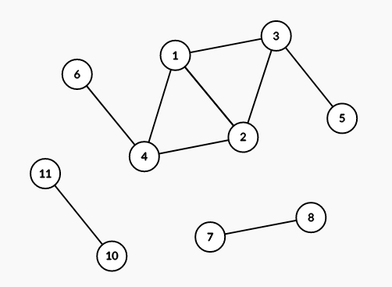
Intro to graph theory
Model of relationships between objects
Appeared on CCC’20 S2, CCC ‘18 S3, CCC ‘16 S3, CCC ‘17 S4, CCC ‘15 S4, and a lot more
Will cover more in detail next week

Slide 9
Graph theory definitions
Graph: model of pairwise relationships between objects
Node/vertex: object in graph
Edge: relationship between two objects
Directed/undirected edge: one way or bidirectional?
Connected/unconnected: is there a path between every pair of vertices in this graph?
Tree: a connected undirected graph with N nodes and N-1 edges
Path between any two nodes is unique

Slide 10
Graph Representation
How do we represent graphs in our code?
There are three major representations:
Adjacency List
Adjacency Matrix
Edge List
The representation used almost always is the adjacency list. For the memory complexity, we will assume that V represents the number of vertices/nodes and E represents the number of edges.

Slide 11
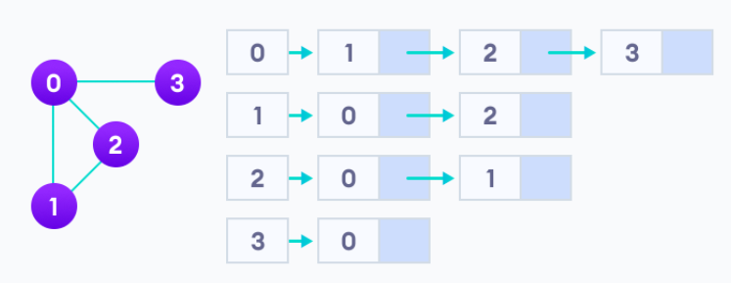
Adjacency List
Memory Complexity: O(V+E)
An adjacency list represents a graph by keeping a list for each node which contains all connected nodes.
This can be done in code by creating an array of lists.
(Ex. adj[2] contains a list of all nodes connected to node 2)

Slide 12
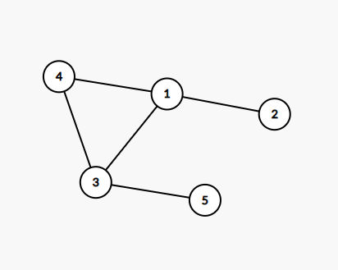
Adjacency List Example
Node | List (Connected Nodes)*
1 | 2, 3, 4
2 | 1
3 | 1, 4, 5
4 | 1, 3
5 | 3
*Note that the connected nodes may not always be in sorted order.

Slide 13
Independent Set
https://dmoj.ca/problem/dpp

Slide 14
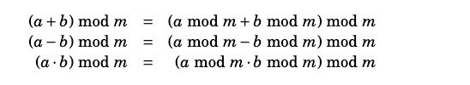
Mod properties
A mod b is the remainder of a/b
Ex: 5 mod 3 = 2, 7 mod 2 = 1
Honestly just stick mod everywhere and it probably™ will be fine unless you are doing division, in which case you need mod inverse
Further reading: page 6 of https://cses.fi/book/book.pdf (cses.fi also has a nice collection of classical/template problems)

Slide 15
Independent Set hints
Highlight black parts to show hints
Hint 1: Pick any node. We want to count the cases where this node is white and this node is black. (This is also our state)
Hint 2: For any node, consider it's “children” (away from root). If we know how many cases where the child is black or white, how can we use that to determine the number of cases the parent is black or white?

Slide 16
Implementations
C++
Optimizations:
Since it is a tree you do not need a visited array, just know which node is the parent
You cannot do this for non-tree graphs or else you get infinite loops
You can also have your dfs function return something so you don’t need to maintain a dp array
Won’t matter though because it’s only o(n) memory and the setters aren't mean
Optimized solution in python: https://pastebin.com/BggcH4zw

Slide 17
Further reading
https://cp-algorithms.com/graph/depth-first-search.html

Slide 18
End <3

